Slide 1
Garbers Church Road – Shared Use Path Project Update
City Council Presentation
Tuesday, April 9, 2019
Department of Public Works
Thomas Hartman, PE, LEED AP
Director of Public Works

Slide 2
Project Timeline
2016 – Received VDOT Revenue Sharing Grant
2016 – Started the Design Phase
2017 – Held a Citizen’s Information Meeting
2017 – Held Design Public Hearing
2018 – Received VDOT Revenue Sharing Grant
2018 – Began Realignment Process
2019 – Ready to Obtain Easements
2020 – Planned Construction

Slide 3
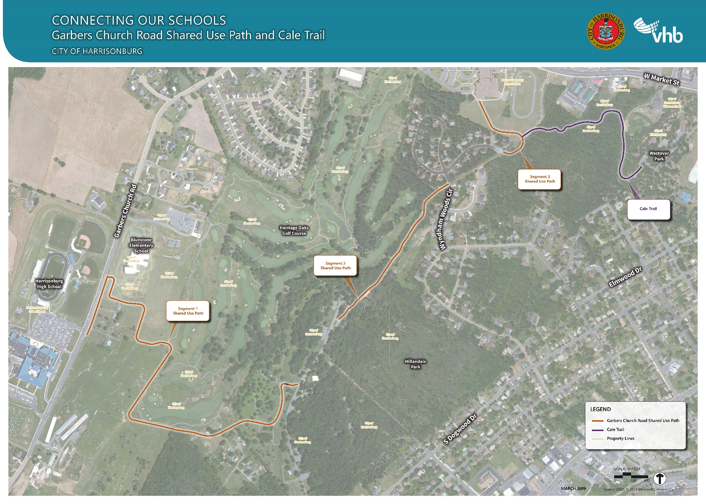
Shared Use Path Alignment

Slide 4
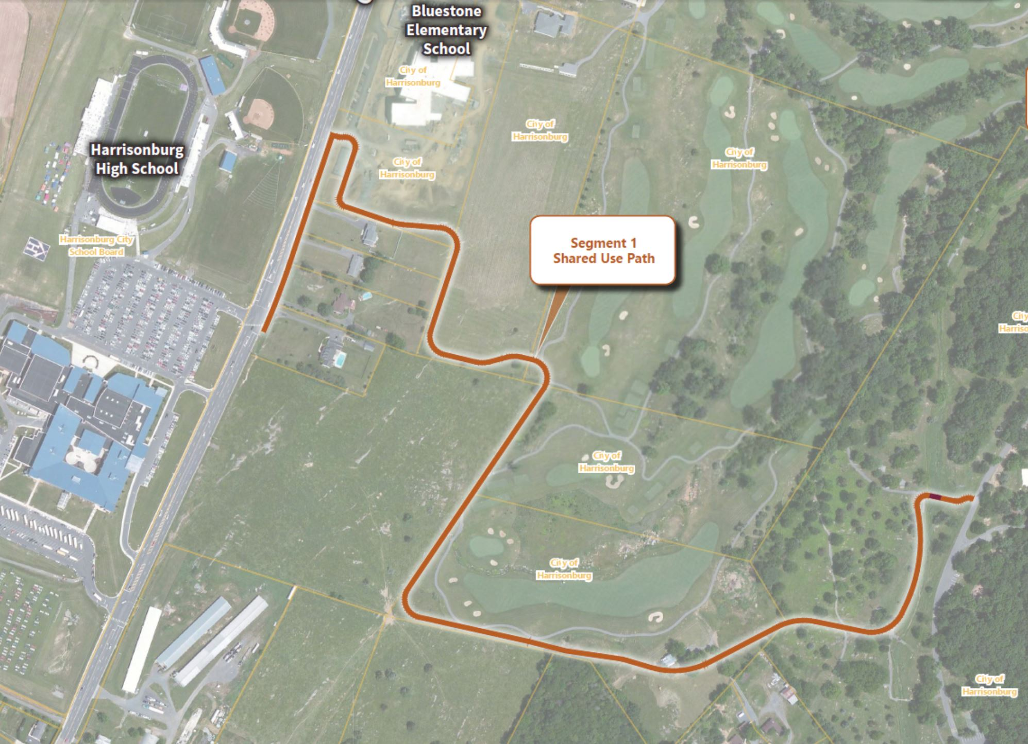
Segment 1

Slide 5
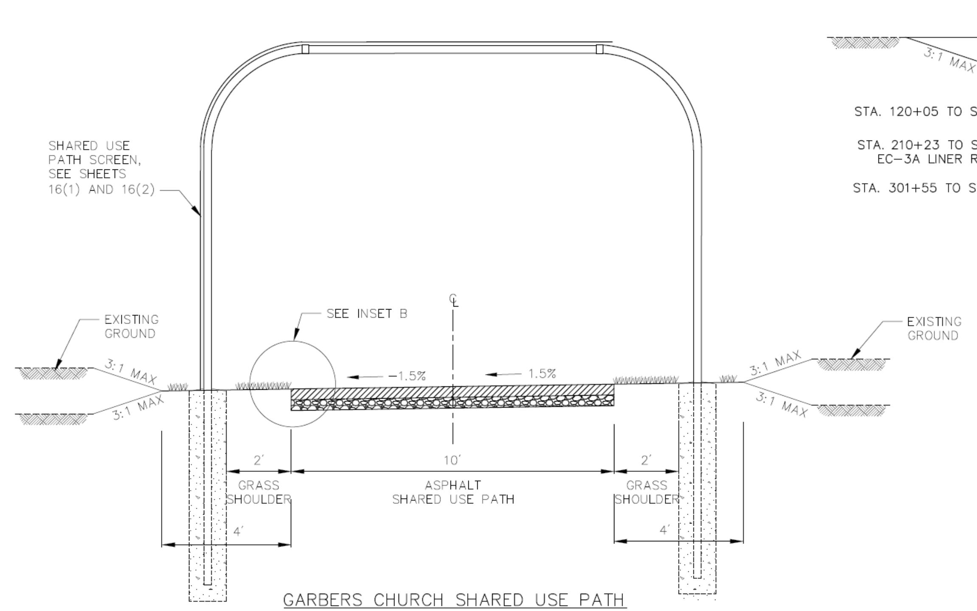
Segment 1 - Fencing

Slide 6
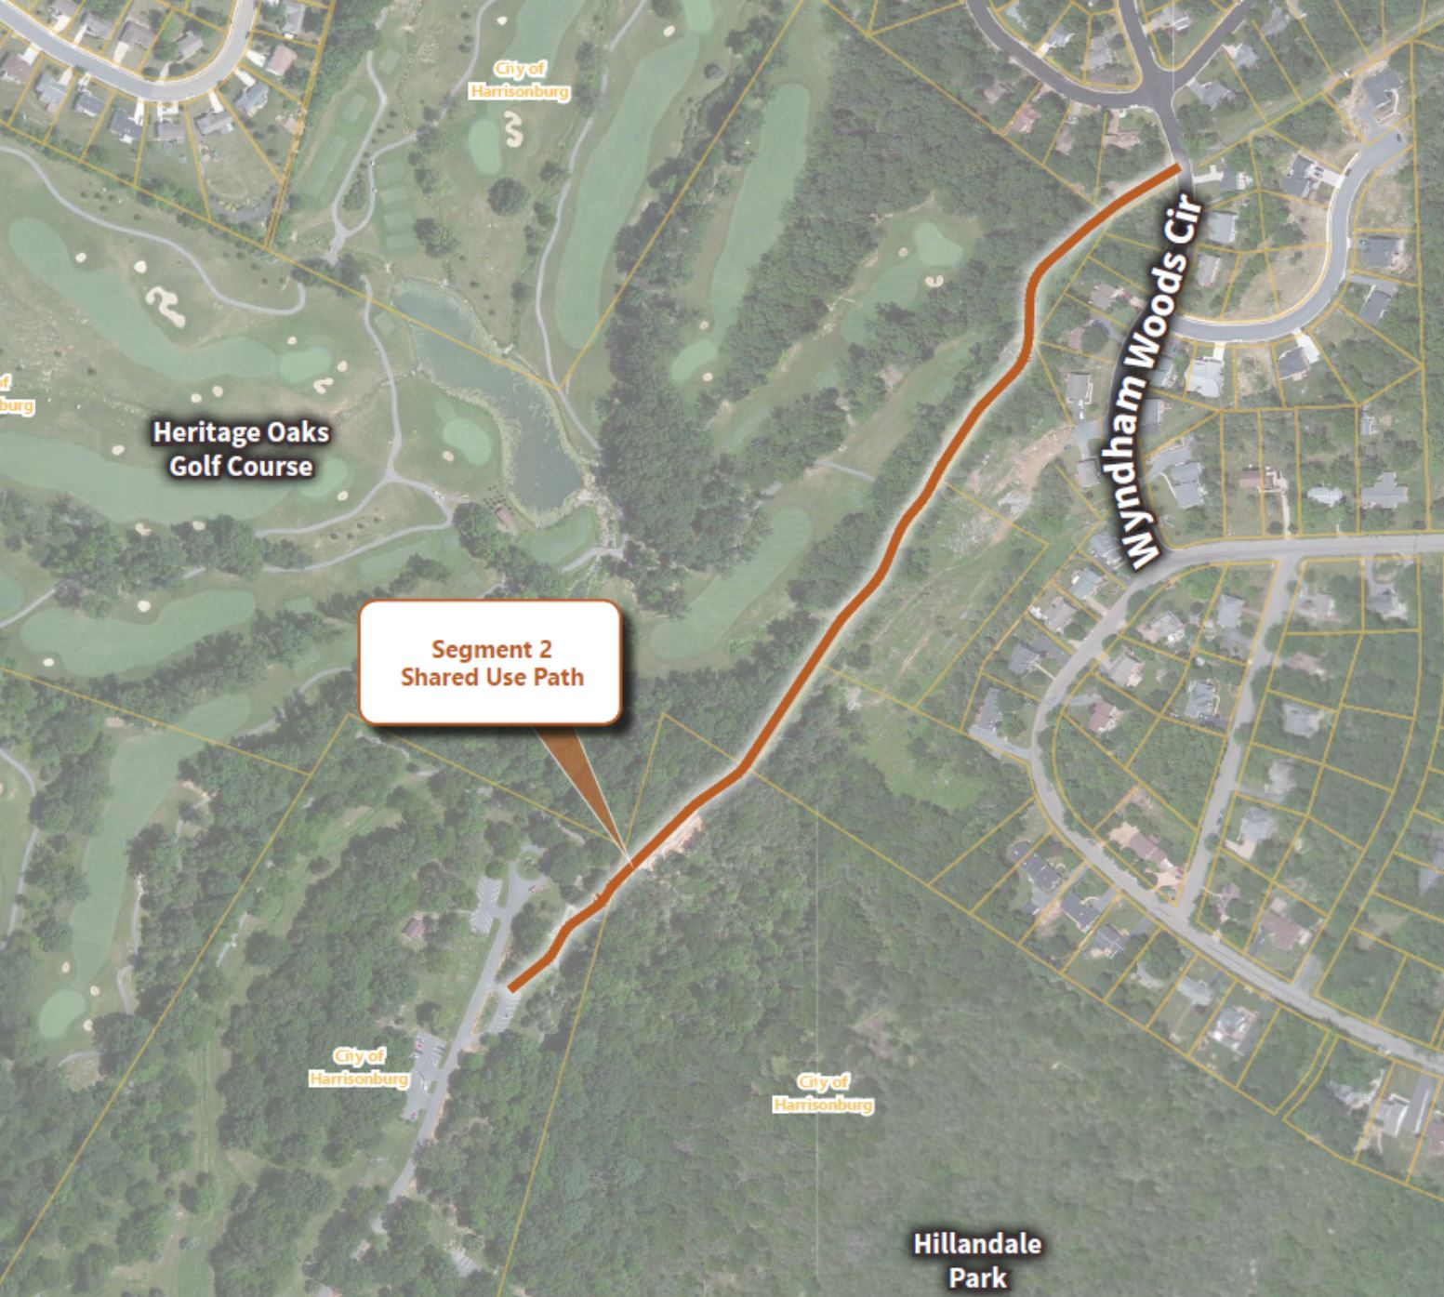
Segment 2

Slide 7
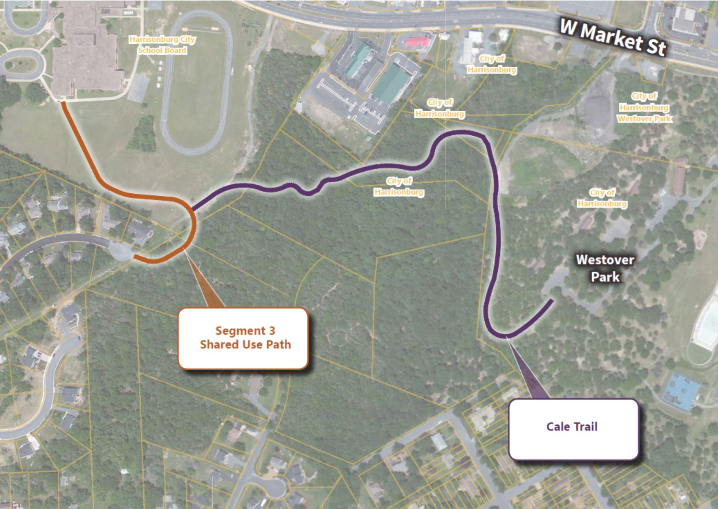
Segment 3

Slide 8
Shared Use Path Alignment

